Slide 1
A highly biased view of WGS analysis
Anthony Fodor
4/15/2024

Slide 2
To download…
Dataset:
https://drive.google.com/file/d/1_WJ5He-frsji1YkdRg5lvdAJVtL52pH9/view?usp=drive_link
(April 1st --→ streamMicrobiome FastQ -→ stream_abundance_table_genus.txt
If you don’t have R installed on your computer:
https://www.r-project.org/

Slide 3
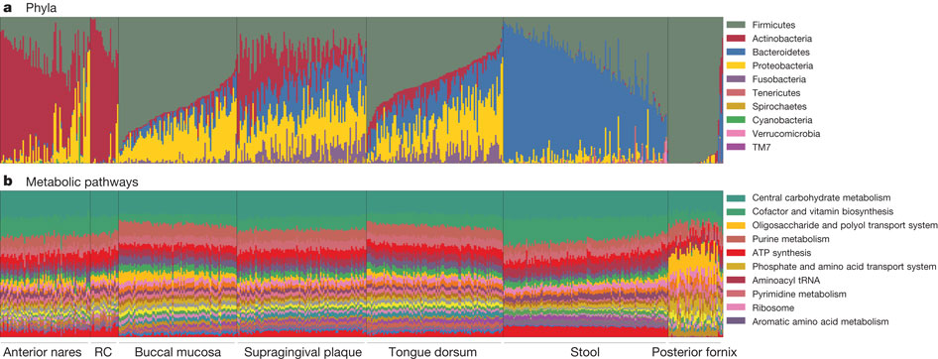
WGS obviously gives function as well as taxonomy
C Huttenhower et al. Nature 486, 207-214 (2012) doi:10.1038/nature11234

Slide 4
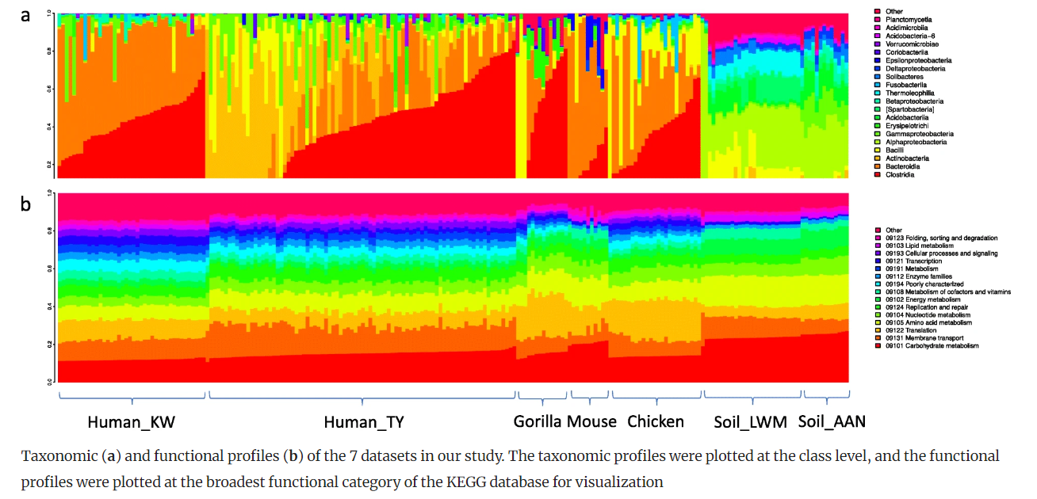
Consistent pathways can be observed beyond the human microbiome
Sun et al. Inference-based accuracy of metagenome prediction tools varies across sample types and functional categories.
Microbiome, 2020

Slide 5
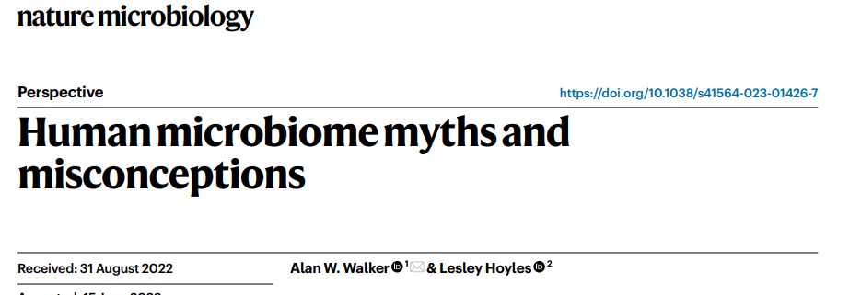
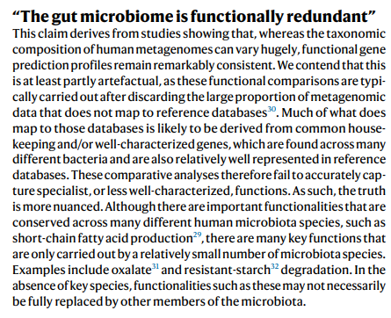
The conclusion that function is more consistent than taxonomy has been controversial…
This reflects one of the challenges of WGS sequencing:
many reads will be unmapped to functional databases.
As we will see, taxonomic classification is also more
challenging on WGS than 16S

Slide 6
Can you predict WGS function just from 16S?
Probably Not

Slide 7
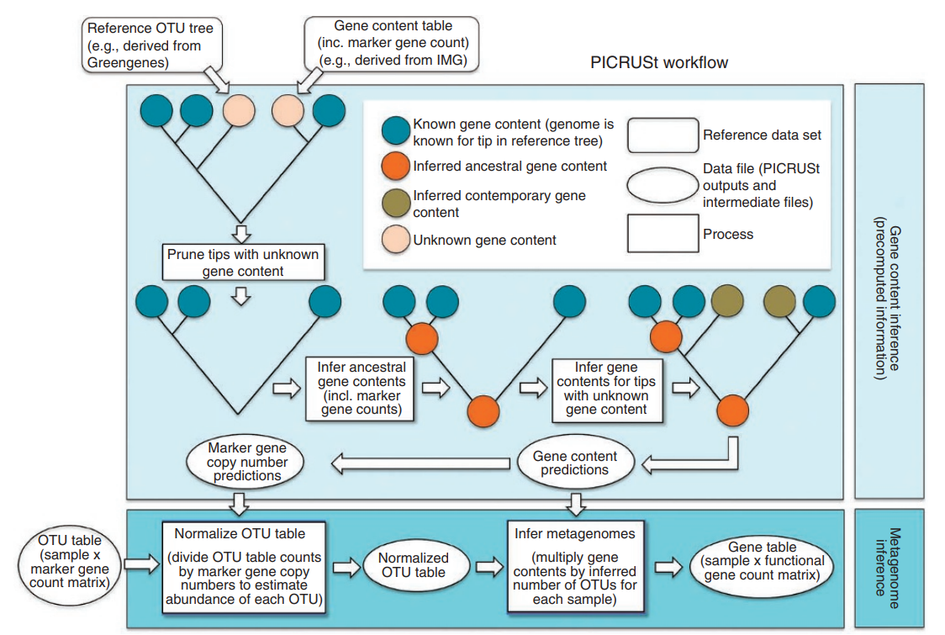
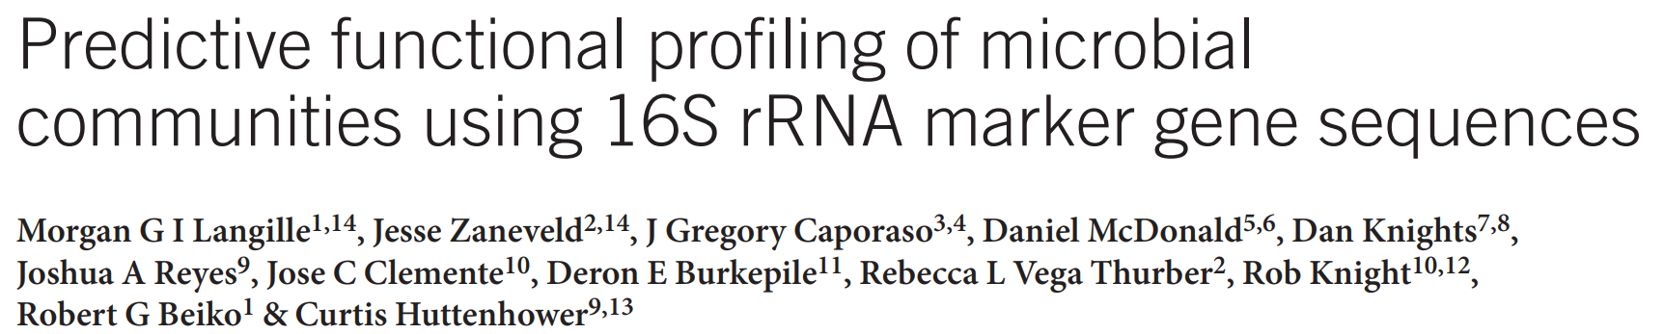

Slide 8
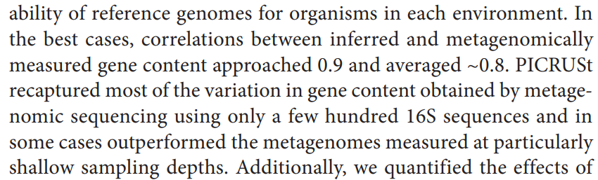
The evidence that these algorithms work initially rely on correlations between predictions from
16S and actual WGS data
But given the uniformity of predictions across all samples, this is problematic…

Slide 9
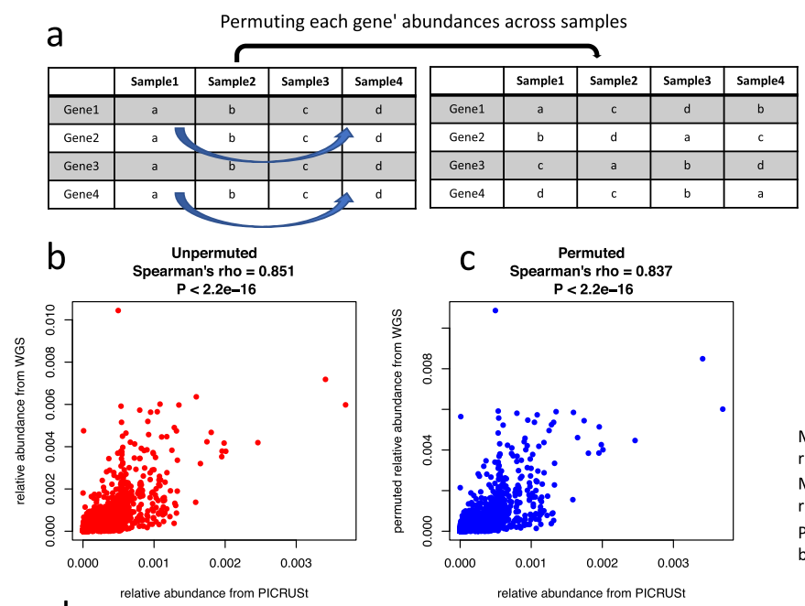
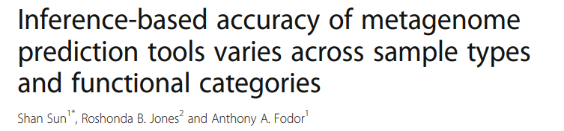
The high correlation between 16S and WGS function is replicated even when randomizing samples

Slide 10
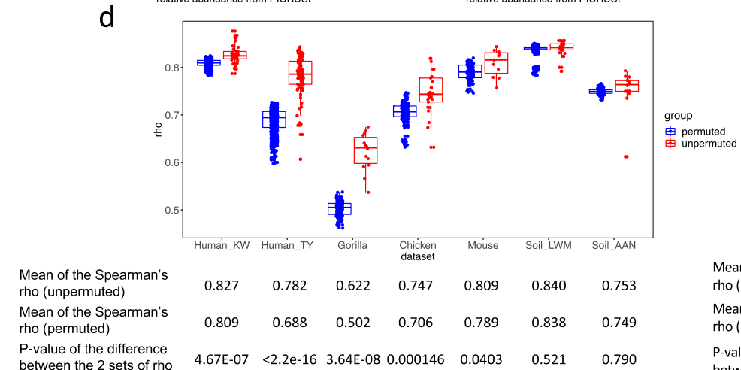
The high correlation between 16S and WGS function is largely replicated even when randomizing samples

Slide 11
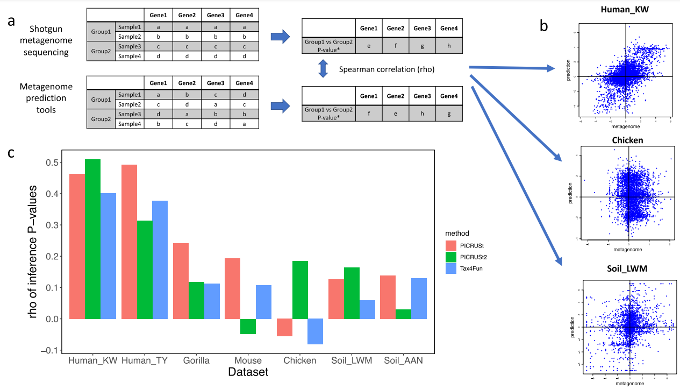
In inference space, the performance of PiCrust is not great anywhere, but is best in humans.

Slide 12
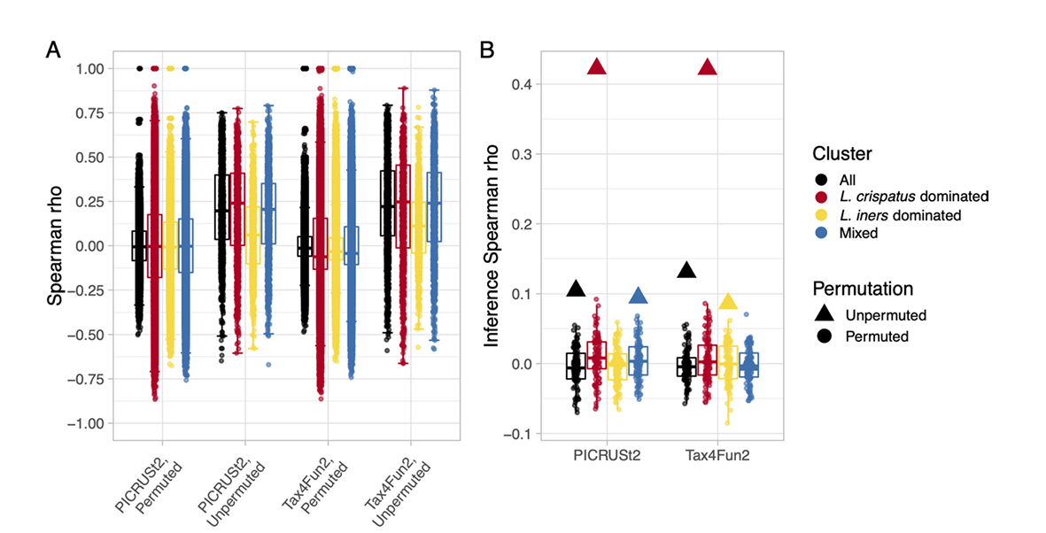

This inference also largely fails for samples outside the human gut

Slide 13
Can you predict WGS function just from 16S?
Probably Not (especially for built environment datasets)

Slide 14
Should I still consider 16S sequence data?
Possibly

Slide 15
WGS gives functional data
WGS can (at least in theory) allow for species/strain resolution on high abundance taxa
WGS can allow for at least partial assembly of genomes from high abundance taxa
These are significant and important advantages of WGS
BUT…
WGS sequence datasets require a lot of disk space and analysis time relative to 16S.
Disk space and analysis time are often a “hidden” cost not considered in the experimental design.
Taxonomic classification of WGS sequences is not (yet) a fully solved problem
Getting functional classification is slow, arduous and often doesn’t classify the majority of sequences
WGS is very challenging on low abundance samples. There are published studies that have successfully
used 16S on the built environment, there seems to be fewer successful WGS examples (but let me know
If you have found papers you think are convincing!).
WGS is often more expensive. Effect sizes are small in most microbiome experiments. Sample size is important.

Slide 16
WGS classification is not yet a solved problem

Slide 17
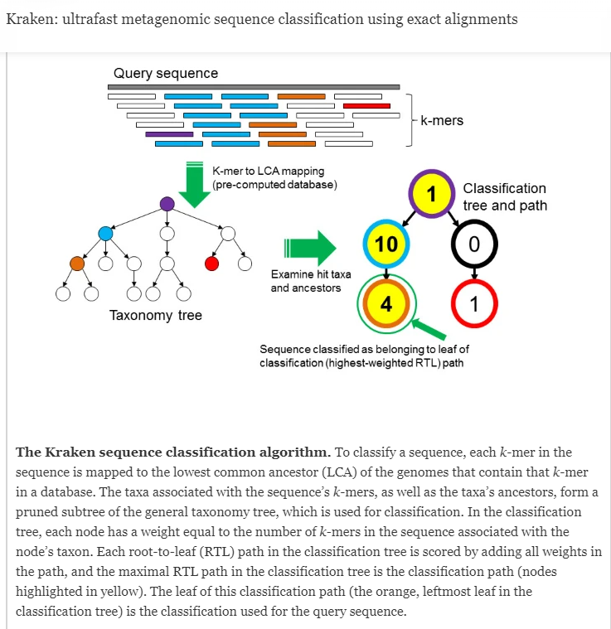
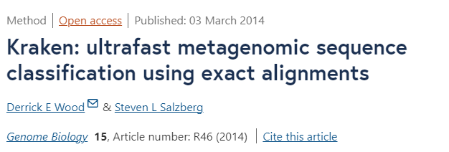

Slide 18
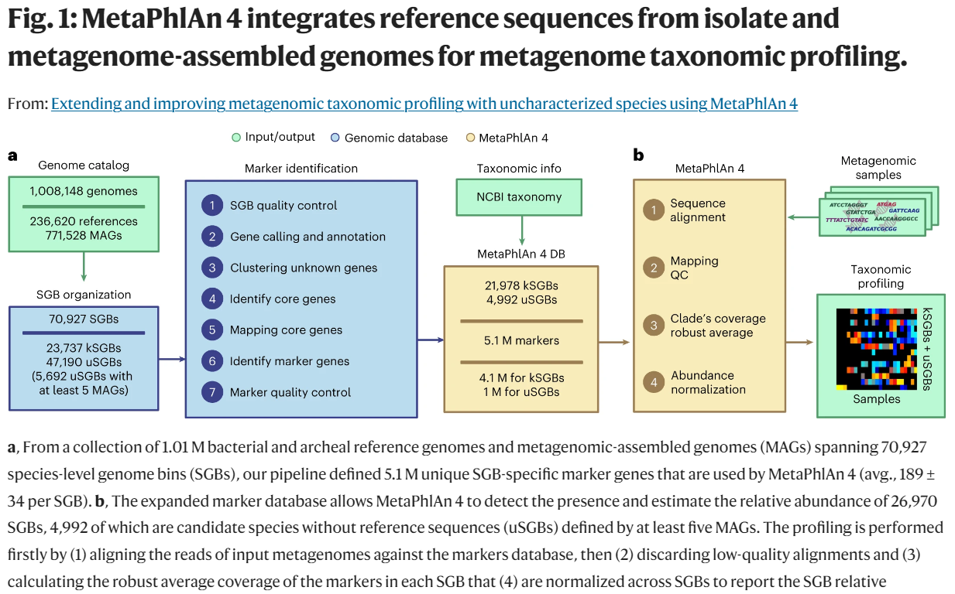

Slide 19
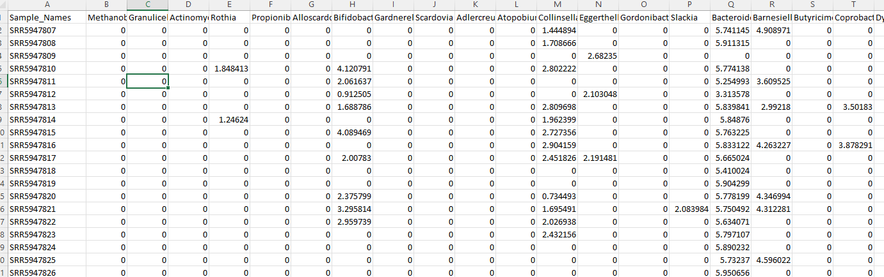
How we view prevalence and richness is very algorithm and method dependent
Metaphlan2 tends to produce very sparse spreadsheets with a few dominant taxa and lots of zeros…

Slide 20
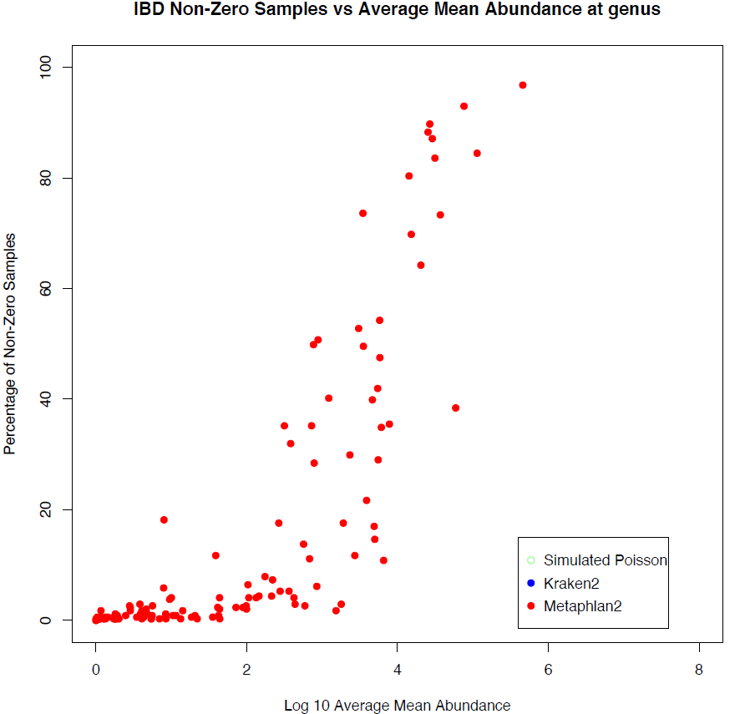
How we view prevalence and richness is very algorithm and method dependent
100
80
60
Percent of non-zero samples
40
20
0
0
2
4
6
8
Log 10 ( abundance )

Slide 21
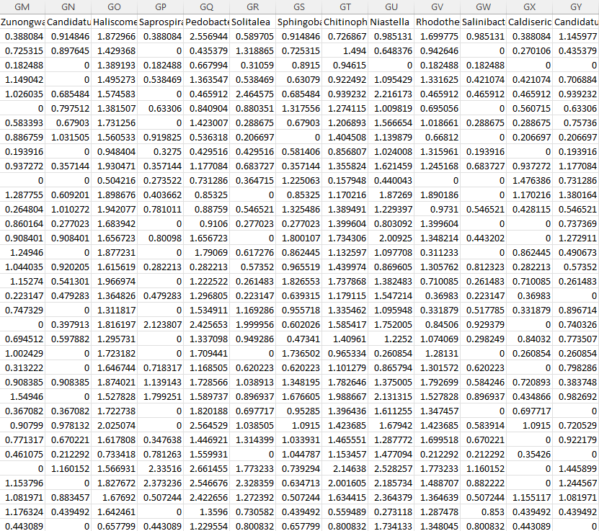
Kraken gives us a much less sparse view of the world…

Slide 22
How we view prevalence and richness is very algorithm and method dependent
100
80
60
Percent of non-zero samples
40
20
0
0
2
4
6
8
Log 10 ( abundance )
Notes:
`

Slide 23
Kraken’s results can be fit by a null model that is unlikely to be explained by biology
100
80
60
Percent of non-zero samples
40
20
0
0
2
4
6
8
Log 10 ( abundance )

Slide 24
Our simplest possible model for classification: “Binomial” or “Poisson” models
You have a very (infinitely) large vat of perfectly mixed ping-pong balls
We model a sequence classification event
(for example, labeling a read represents a sequence variant)
as the probability of randomly drawing red balls from a set of sequences
N – the total number of sequences in a sample (the red balls + the white balls observed)
p – the fraction of all balls in the vat that belong to a variant
If N is large and p is small we say this is a Poisson process.
We draw a 1,000 ping pong balls (sequences) with a “true”
relative abundance of 0.1%, we would expect 1 red ping pong balls.

Slide 25
If N is large and p is small we say this is a Poisson process.
We draw a 1,000 ping pong balls (sequences) with a “true”
relative abundance of 0.1%, we would expect 1 red ping pong balls.
We can produce our expectation under such a null model very easily in a language such as R

Slide 26
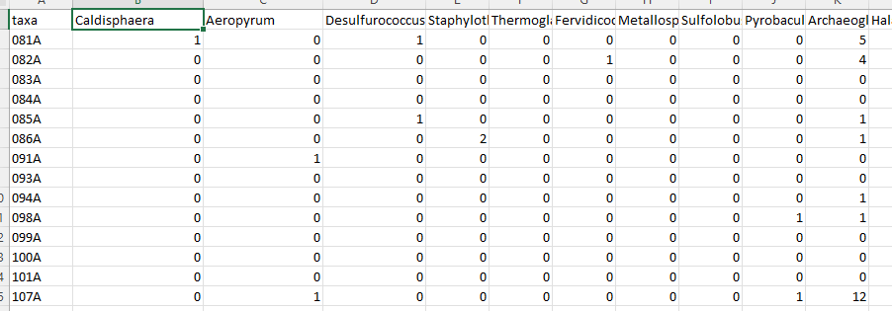
We can generate an entire “simulated” dataset under the Poisson null
Taxa
Samples
Each cell counts how many “red balls” (that taxa) from all the balls in the sample.

Slide 27
Features of a Poisson null model:
No biology (constant background error rate irrespective of sample type of phenotype)
Mean = variance

Slide 28
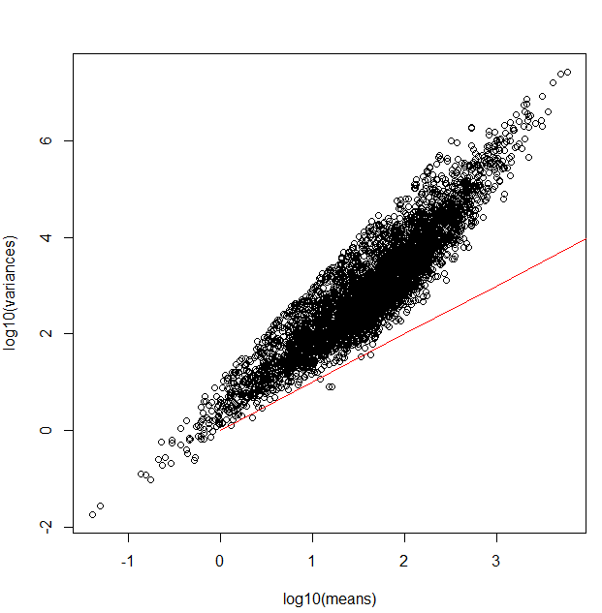
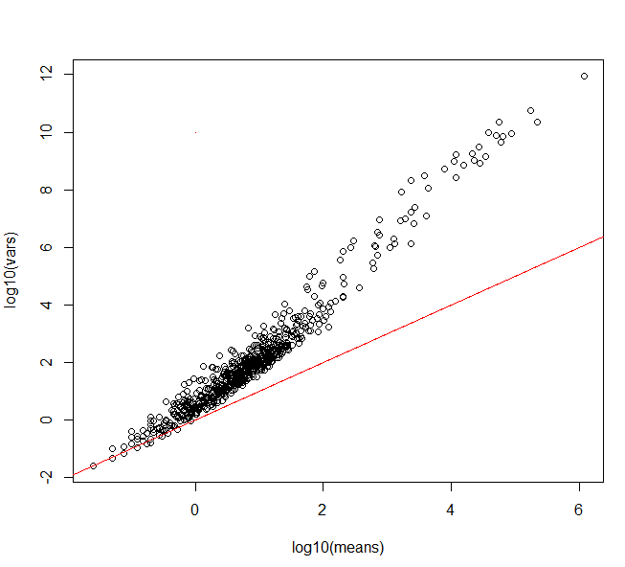
Poisson processes are reliably inadequate for modeling counts tables in genomics experiments
RNA- seq dataset
WGS dataset (through Kraken)
Log10 (variance)
Log10 (variance)
Independent draws across
samples with a constant
relative abundance
Log10 (mean)
Log10 (mean)

Slide 29
Poisson processes are reliably inadequate for modeling counts tables in genomics experiments
RNA- seq dataset
WGS dataset (through Kraken)
Log10 (variance)
Log10 (variance)
Independent draws across
samples with a constant
relative abundance
Log10 (mean)
Log10 (mean)

Slide 30
Poisson processes are reliably inadequate for modeling counts tables in genomics experiments
RNA- seq dataset
WGS dataset (through Kraken)
Log10 (variance)
Log10 (variance)
Independent draws across
samples with a constant
relative abundance
Log10 (mean)
Log10 (mean)

Slide 31
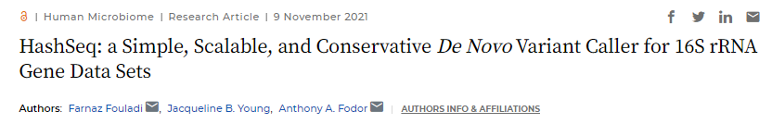



Poisson processes can be surprisingly useful in describing accumulation (richness) of sequence variants
Jack Young
Farnaz Fouladi

Slide 32
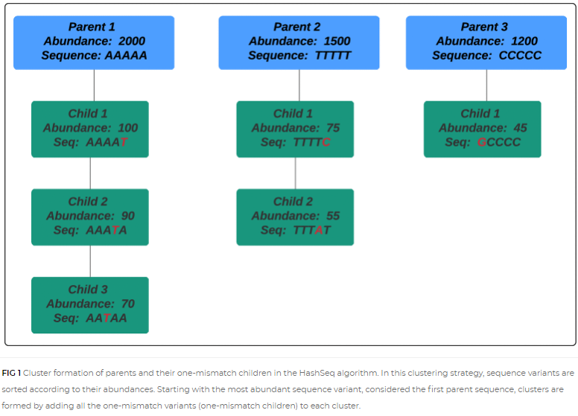
Identify all unique 16S sequences in a dataset.
Sort by abundance – find children (“single mismatch”) variants
https://journals.asm.org/doi/full/10.1128/mSystems.00697-21

Slide 33
Richness is well described across datasets by a simple Poisson process with a constant error rate

Slide 34
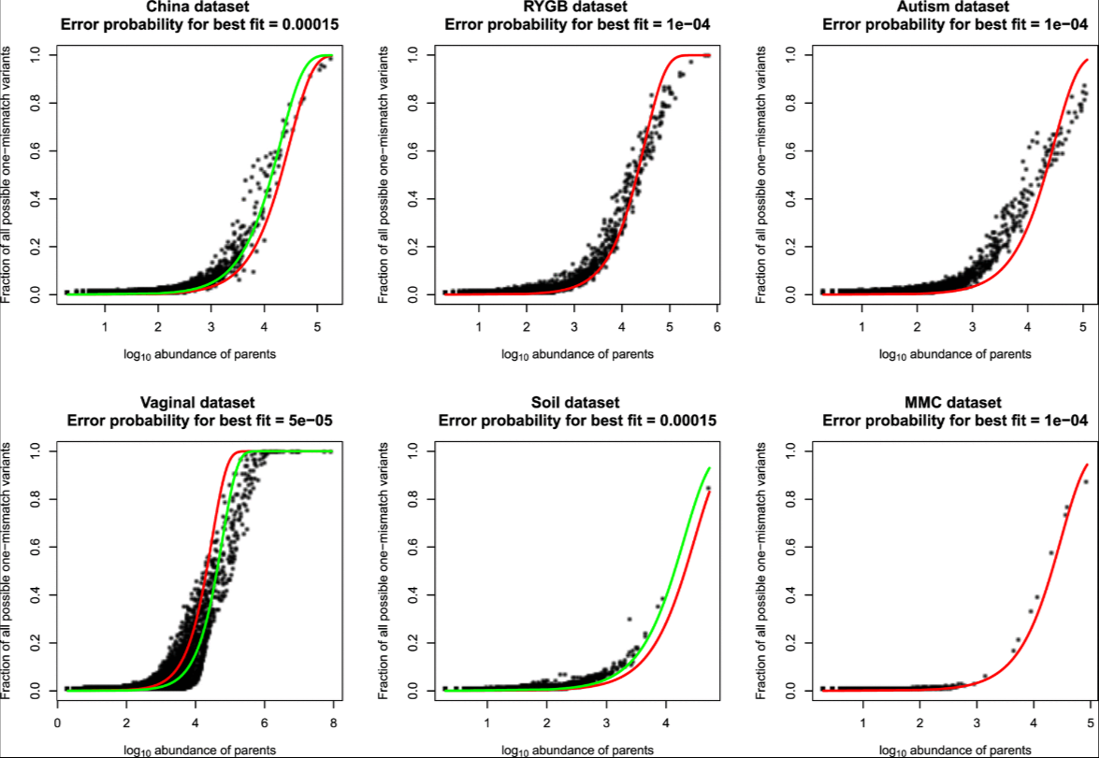
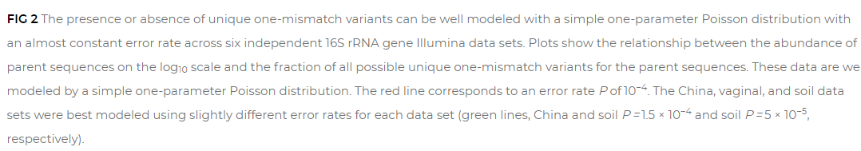
Richness is well described across datasets by a simple Poisson process with a constant error rate
Constant error rate
Best error rate
for that data set

Slide 35
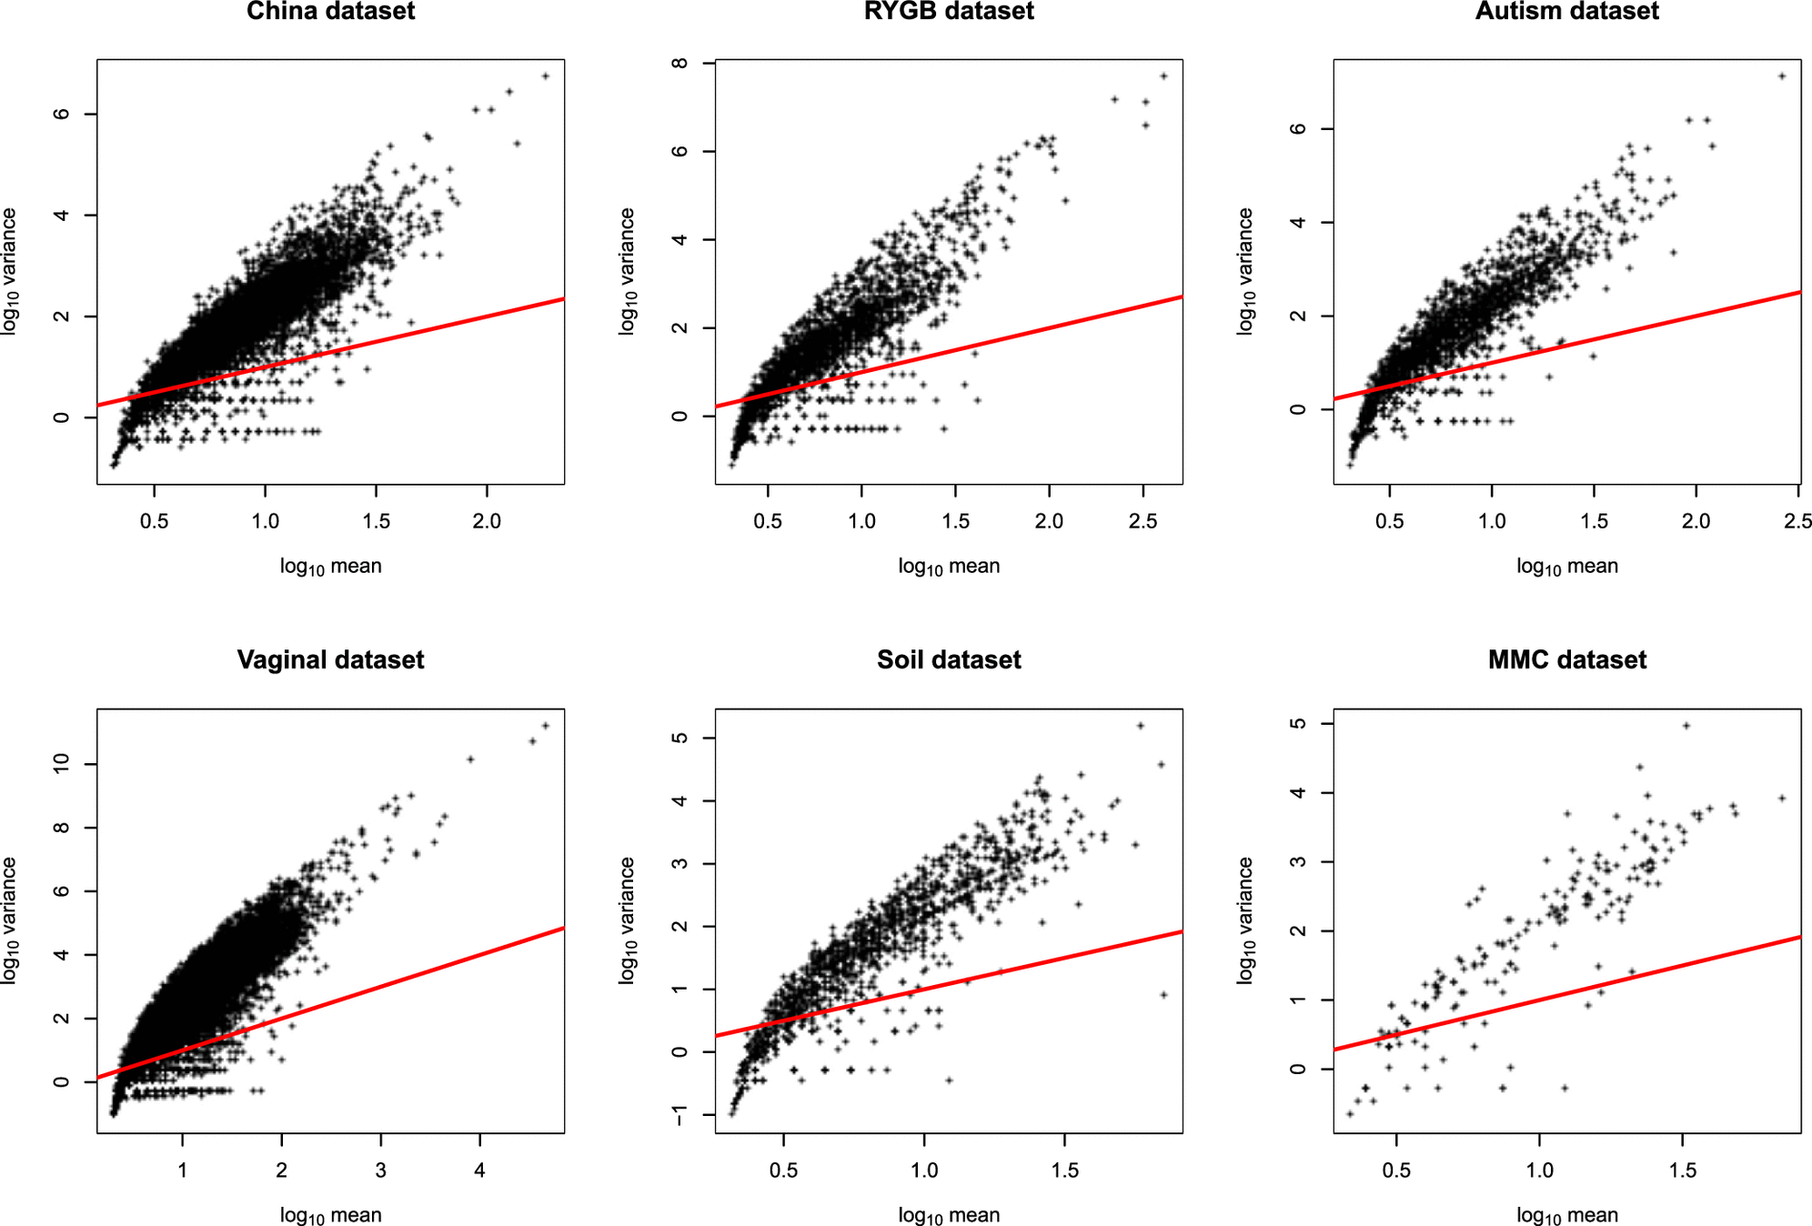
Abundance (as usual) is not well fit by Poisson assumptions

Slide 36
Richness is well described across datasets by a simple Poisson process with a constant error rate
Abundance (as usual) is not well fit by Poisson assumptions
One hypothesis:
In 16S experiments, initial errors accumulate by taq sequencing error (a Poisson process)
The final abundance is dependent on PCR amplification (not a Poisson process)

Slide 37
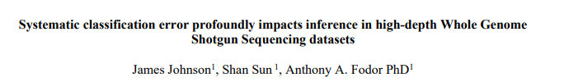


Surprisingly, Poisson algorithms can also be of utility in shotgun sequencing datasets
James Johnson
Shan Sun
Bioarchive (and unpublished!)
https://www.biorxiv.org/content/10.1101/2022.04.04.487034v2.abstract

Slide 38
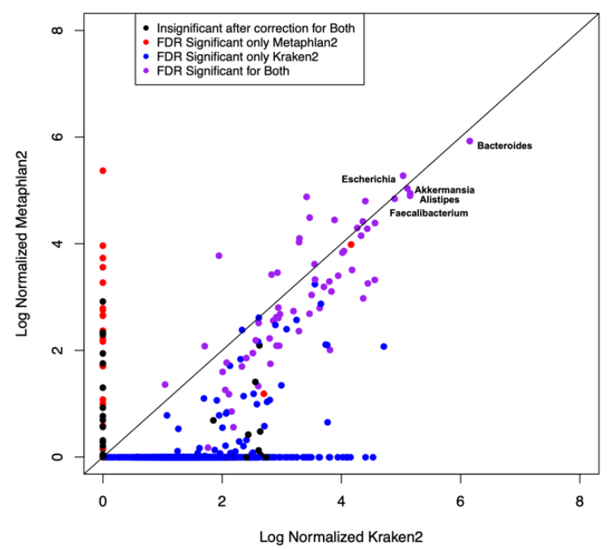
Kraken and Metaphlan agree on high-abundance taxa but not on low-abundance taxa
Kraken finds not only more taxa but more taxa significantly associated with metadata
Inference is case/control
For IBD at a 5% FDR threshold
Log 10 (mean Metaphlan 2)
Log 10 (mean Kraken 2)

Slide 39
Can we evaluate the algorithms even though we don’t know the “correct” answer…
Examine the correlation structure of predictions
Sort all taxa by abundance
1st most abundance – Bacteroides
2nd most abundance – Escherichia
3rd most abundant – Akkermansia
4th most abundant – Alistipes
…
…
For each taxa, report the highest correlation coefficient among all more abundant taxa
So for the 2nd most abundant, this will be the correlation with the 1st most abundance
For the 3rd most abundant, this will be the max( cor(3rd, 2nd), cor(3rd , 1st))
For the 4th most abundance, this be the max( cor(4th, 1st), cor(4th, 2nd), cor(4th, 3rd) )
And so forth…

Slide 40
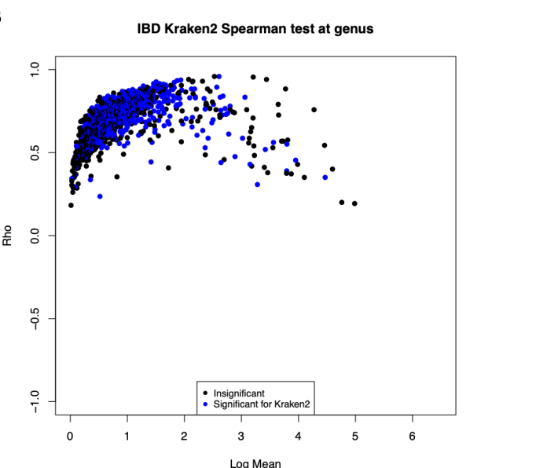
Many of taxa for Kraken are highly correlated with a more abundant “parent” taxa
Rho
Log 10 (mean Kraken 2)

Slide 41
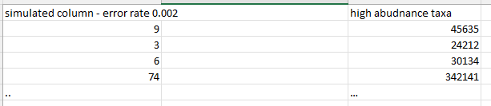
We can model this behavior with a simple Poisson-based procedure with a small # of free parameters
Assume the top 10 taxa are “real”.
Simulate the rest of the dataset as Poisson based sampling error:
for each “simulated” taxa
randomly choose one of
randomly choose an error rate over some range (e.g. 0 < error <= 0.002 )
sum(rpois(45635, lambda = .0002))

Slide 42
We can model this behavior with a simple Poisson-based procedure with a small # of free parameters
Assume the top 10 taxa are “real”.
Simulate the rest of the dataset as Poisson based sampling error:
for each “simulated” taxa
randomly choose one of
randomly choose an error rate over some range (e.g. 0 < error <= 0.002 )
sum(rpois(24212, lambda = .0002))

Slide 43
We can model this behavior with a simple Poisson-based procedure with a small # of free parameters
Assume the top 10 taxa are “real”.
Simulate the rest of the dataset as Poisson based sampling error:
for each “simulated” taxa
randomly choose one of
randomly choose an error rate over some range (e.g. 0 < error <= 0.002 )
sum(rpois(30134, lambda = .0002))

Slide 44
We can model this behavior with a simple Poisson-based procedure with a small # of free parameters
Assume the top 10 taxa are “real”.
Simulate the rest of the dataset as Poisson based sampling error:
for each “simulated” taxa
randomly choose one of
randomly choose an error rate over some range (e.g. 0 < error <= 0.002 )
sum(rpois(342141, lambda = .0002))

Slide 45
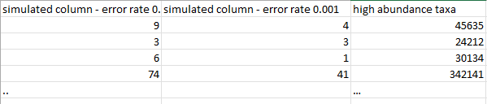
We can model this behavior with a simple Poisson-based procedure with a small # of free parameters
Assume the top 10 taxa are “real”.
Simulate the rest of the dataset as Poisson based sampling error:
for each “simulated” taxa
randomly choose one of
randomly choose an error rate over some range (e.g. 0 < error <= 0.002 )
sum(rpois(45635, lambda = .0001))

Slide 46
We can model this behavior with a simple Poisson-based procedure with a small # of free parameters
Assume the top 10 taxa are “real”.
Simulate the rest of the dataset as Poisson based sampling error:
for each “simulated” taxa
randomly choose one of
randomly choose an error rate over some range (e.g. 0 < error <= 0.002 )
sum(rpois(24212, lambda = .0001))

Slide 47
We can model this behavior with a simple Poisson-based procedure with a small # of free parameters
Assume the top 10 taxa are “real”.
Simulate the rest of the dataset as Poisson based sampling error:
for each “simulated” taxa
randomly choose one of
randomly choose an error rate over some range (e.g. 0 < error <= 0.002 )
sum(rpois(30134, lambda = .0001))

Slide 48
We can model this behavior with a simple Poisson-based procedure with a small # of free parameters
Assume the top 10 taxa are “real”.
Simulate the rest of the dataset as Poisson based sampling error:
for each “simulated” taxa
randomly choose one of
randomly choose an error rate over some range (e.g. 0 < error <= 0.002 )
sum(rpois(342141, lambda = .0001))
In this way we simulate the entire dataset assuming that everything except the
most abundant taxa is Poisson-based classification error of the most abundant taxa

Slide 49
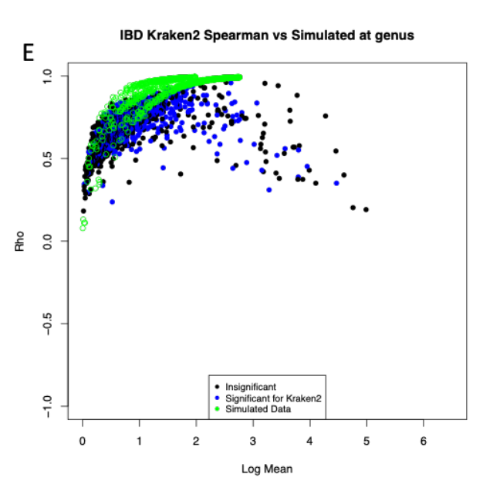
Somewhat remarkably, this simple model captures much of the behavior of low-abundance Kraken taxa
Rho
Log 10 (mean Kraken 2)

Slide 50
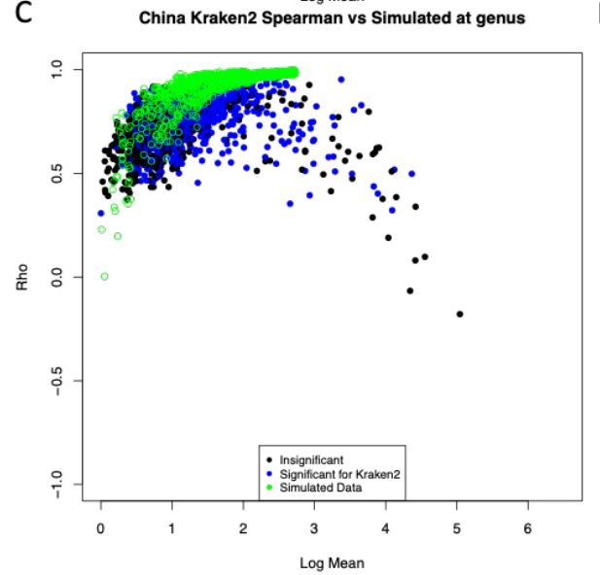
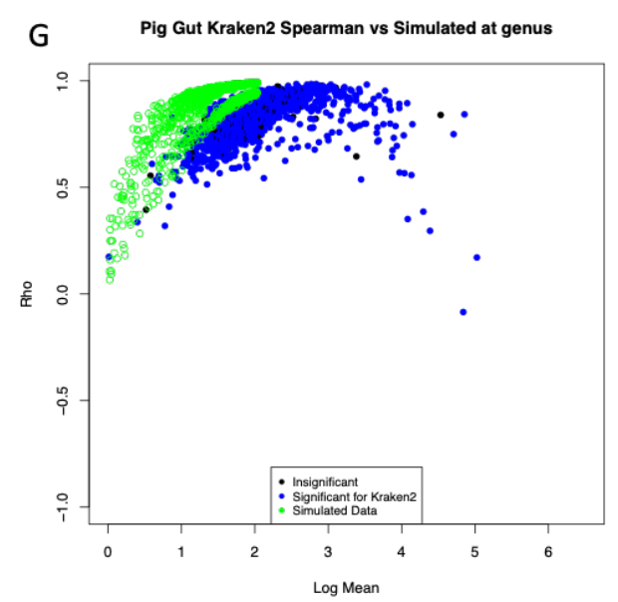
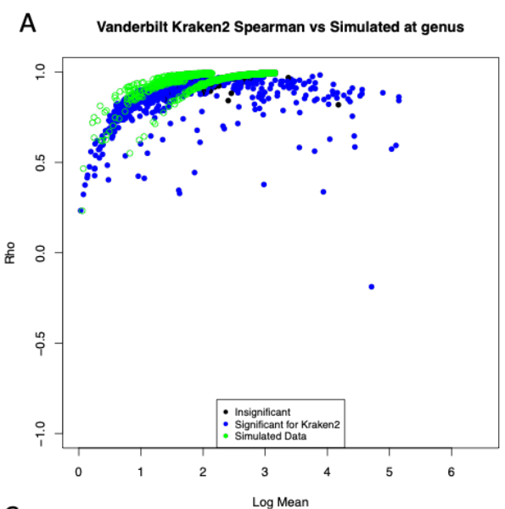
A constant error rate fits three of four datasets very well

Slide 51
We can explain much of the prevalence relationship from Kraken with our Poisson model
(alas, with a different background error rate….)
100
80
60
Percent of non-zero samples
40
20
0
0
2
4
6
8
Log 10 ( abundance )

Slide 52
Mis-classification events from k-mer classifiers of WGS can be well modeled
with a Poisson distribution with no biology in the null model
Spurious correlations can be problematic for network analysis
Low abundance taxa with high correlations to high abundance taxa should be independently confirmed
as being actually present and not “phantom”
Filtering thresholds for WGS datasets should be set from abundance (not prevalence!)
Mis-classification events become more likely as sequencing depth and database density increase!
Error models may allow us to capture background expectations and evaluate null hypotheses
that a given observation of a taxa can be explained by background error rate calculations…
We have such a model for 16S ASVs and are working towards that in WGS
WGS analysis can be inherently more challenging than 16S and popular algorithms have fundamental
disagreements about how to interpret WGS data
A significant result with metadata does not mean the taxon is actually present.

Slide 53
What kind of quick visualizations can I make
(and do I still need to know how to code?)

Slide 54
So we are starting with the file “stream_abundance_table_genus.txt” from your previous labs…
I verified with Excel that each column sums to 100 so we are in relative abundance space
downstream from some classification algorithm…
Dr. Gibas writes “The sample names UPA/RES/ATE/DSA
mean upstream, residential influent, aeration tank effluent, downstream
It's just one timepoint, and the data is quality-filtered already and downsampled to 25%,
because that makes it fast and small enough for the student cluster”
So this is NOT publication ready data but good enough to try some stuff…

Slide 55
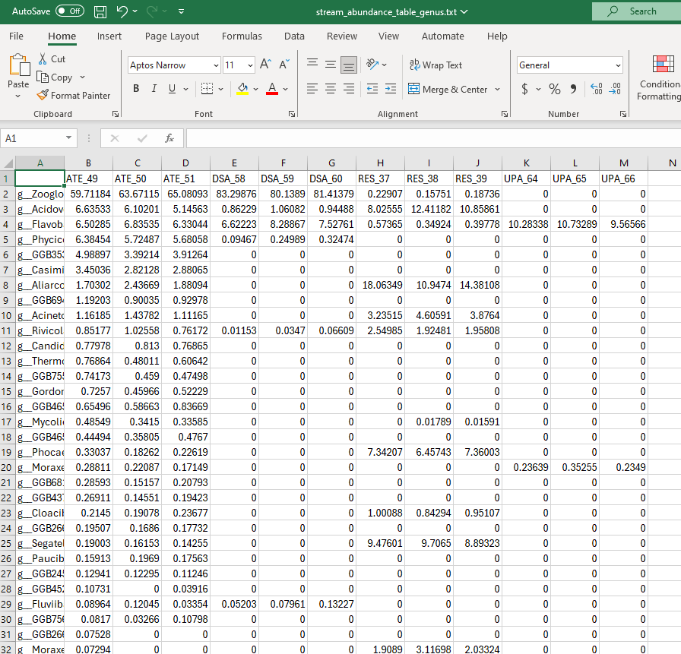
We have a sparse matrix with 12 samples and 200 taxa

Slide 56
We can do some simple explorations of the data before we even make visualizations…
Just sort the data by the mean across all samples
library("vegan")
inFile <- "C:\\query\\stream_abundance_table_genus.txt"
myT <- read.table(inFile, sep="\t", header=TRUE,row.names=1)
averages <- apply(myT,1,mean)
myT <- myT[ order(averages,decreasing=TRUE), ]
edit(myT)

Slide 57
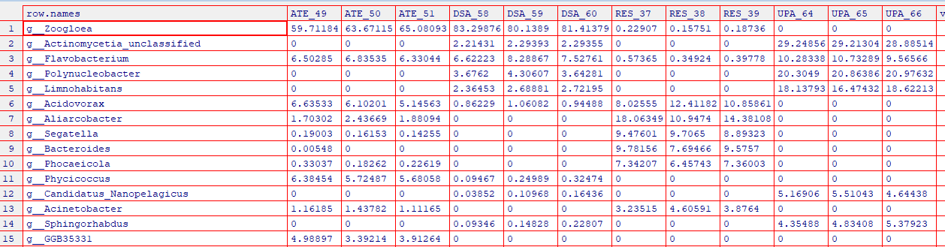
I would be concerned that the first 5 taxa were contaminants..
I would want to see a negative control strategy
and maybe even validation by culture, qPCR, 16S sequencing etc. etc.
Questions for my collaborators: Are these low biomass samples?
Can we estimate total biomass using qPCR or culture or something else?

Slide 58
Can we use ChatGTP 3.5 to make a heatmap?
Yes
I have a tab delimited text file with filepath "C:\query\stream_abundance_table_genus.txt" where the first row is a header and the first column can be ignored. Can you make R code to make a heat map?
# Install and load required packages
install.packages("gplots")
library(gplots)
# Read the tab-delimited file
data <- read.table("C:/query/stream_abundance_table_genus.txt", header=TRUE, row.names=1, sep="\t")
# Create the heatmap
heatmap.2(as.matrix(data),
scale="row", # Scale rows
col = cm.colors(256), # Color scheme (you can change it)
trace="none", # Turn off trace lines
margins=c(8,10), # Set margins for row and column labels
main="Heatmap of Abundance Table (Genus)", # Title of the heatmap
key = TRUE, # Include color key
keysize = 1.5, # Size of color key
cexRow = 0.5, # Size of row labels
cexCol = 0.5 # Size of column labels
)
We don’t trust ChatGPT very much but this code seems fine….

Slide 59
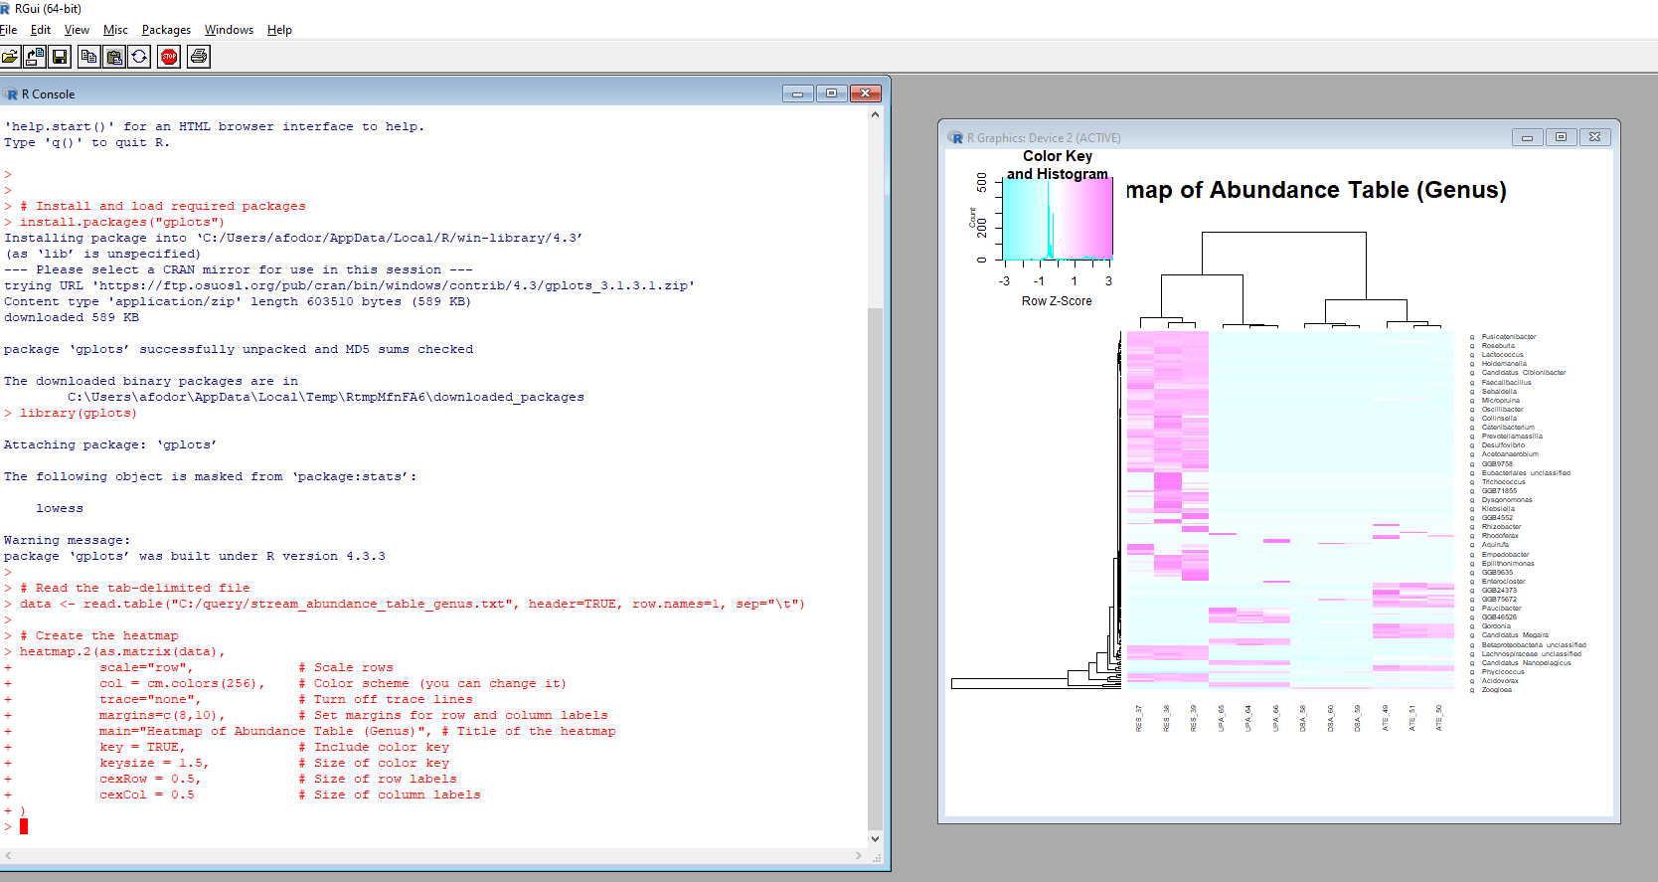
You can use Rstudio (or another text editor) but you can also literally paste the code directly into R..
My text editors of choice are Gvim and Eclipse. You should find a text editor you like!

Slide 60
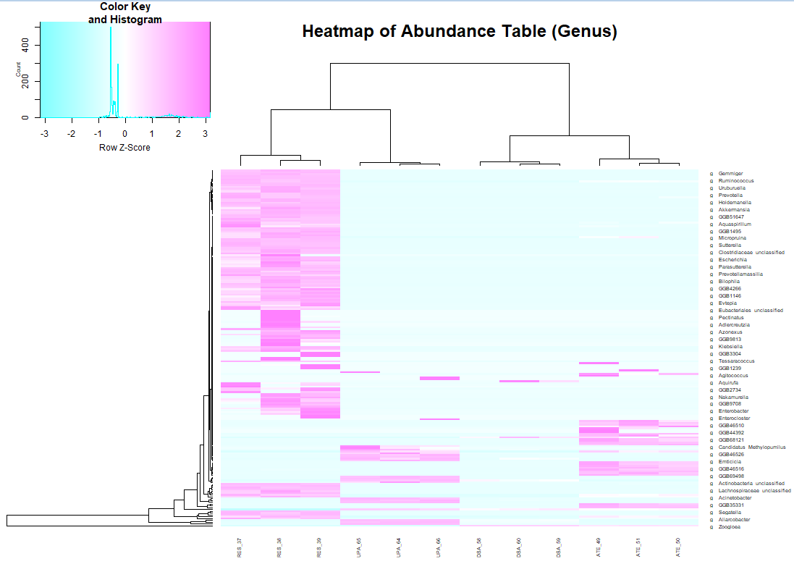
Pretty nice result for no effort….

Slide 61
I can ask ChatGPT to adjust the parameters to make it look better, but I can also figure this out for myself
(again in a text editor)
# Install and load required packages
install.packages("gplots")
library(gplots)
# Read the tab-delimited file
data <- read.table("C:/query/stream_abundance_table_genus.txt", header=TRUE, row.names=1, sep="\t")
# Create the heatmap
heatmap.2(as.matrix(data),
scale="row", # Scale rows
col = cm.colors(256), # Color scheme (you can change it)
trace="none", # Turn off trace lines
margins=c(8,10), # Set margins for row and column labels
main="Sample wastewater data", # Title of the heatmap
key = TRUE, # Include color key
keysize = 1.5, # Size of color key
cexRow = 1, # Size of row labels
cexCol = 2 # Size of column labels
)

Slide 62
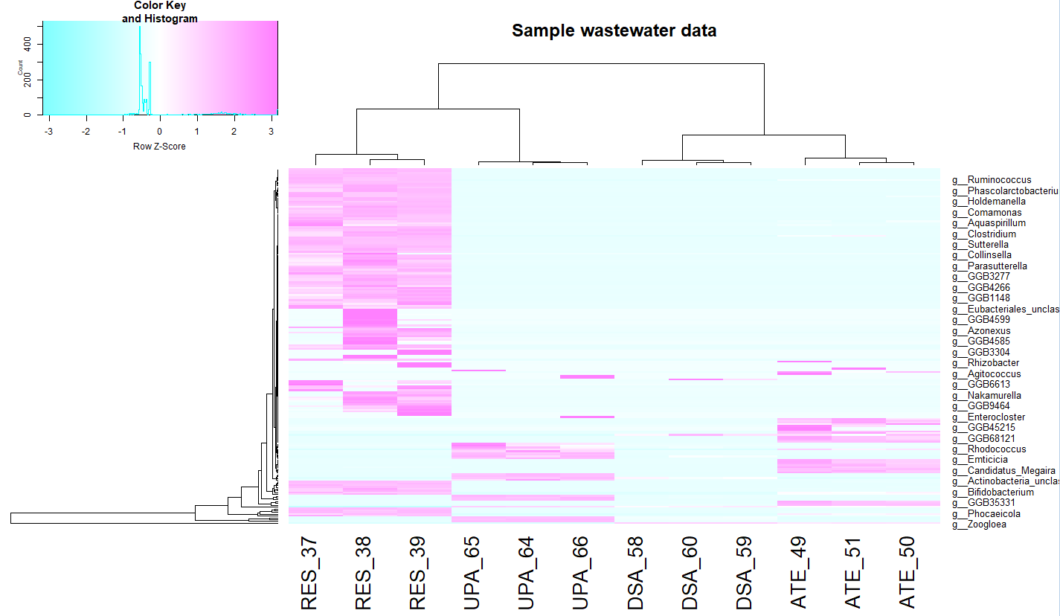
Pretty happy with that…

Slide 63
I can have ChatGPT make the changes and ask for additional changes
Can you make the color scheme red/blue, set the title to "Sample Wastwater Data", set cexRow to 1and cexCol to 2?
# Install and load required packages
install.packages("gplots")
install.packages("RColorBrewer")
library(gplots)
library(RColorBrewer)
# Read the tab-delimited file
data <- read.table("C:/query/stream_abundance_table_genus.txt", header=TRUE, row.names=1, sep="\t")
# Create the heatmap with red/blue color scheme and other customizations
heatmap.2(as.matrix(data),
scale="row", # Scale rows
col = bluered(256), # Red/blue color scheme
trace="none", # Turn off trace lines
margins=c(8,10), # Set margins for row and column labels
main="Sample Wastewater Data", # Title of the heatmap
key = TRUE, # Include color key
keysize = 1.5, # Size of color key
cexRow = 1, # Size of row labels
cexCol = 2 # Size of column labels
)

Slide 64
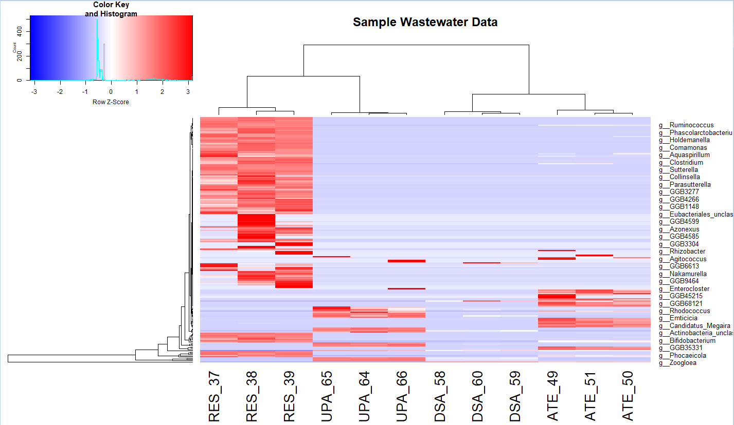
We approach a publication ready figure with very little effort…

Slide 65
A 2-dimension heat map is one kind of clustering what about other kinds of clustering?
Here we ask ChatGPT 3.5 to do a PCOA
I have a tab delimited text file with filepath "C:\query\stream_abundance_table_genus.txt" where the first row is a header and the first column can be ignored. Can you make R code to perform PCOA based on Bray-Curtis dissimilarity?
# Install and load required packages
install.packages("vegan")
library(vegan)
# Read the tab-delimited file
data <- read.table("C:/query/stream_abundance_table_genus.txt", header=TRUE, row.names=1, sep="\t")
# Ignore the first column
data <- data[, -1]
# Calculate Bray-Curtis dissimilarity
bc_diss <- vegdist(data, method="bray")
# Perform PCoA
pcoa_result <- pcoa(bc_diss)
# Plot PCoA
plot(pcoa_result, main="PCoA based on Bray-Curtis dissimilarity")

Slide 66
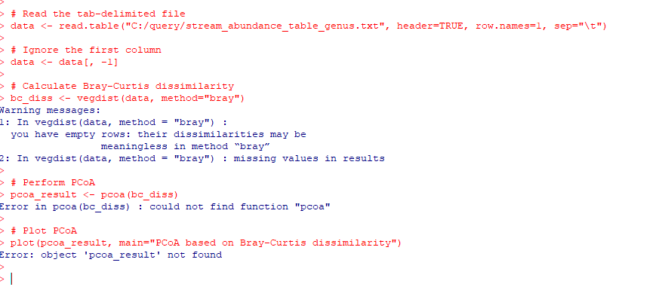
This code seems reasonable but does not run…
So ChatGPT 3.5, while incredibly impressive, is a long way from finished.
(I didn’t try Copilot or ChatGPT 4.0 or any other platform)
(I also didn’t try to engineer my query to fix the problem).
So sometimes it is faster/easier to just know how to code what you are looking for.
At least for now…

Slide 67
Here is one version of the code that we are looking for…
library("vegan")
inFile <- "C:\\query\\stream_abundance_table_genus.txt"
myT <- read.table(inFile, sep="\t", header=TRUE,row.names=1)
myTData <- t(myT)
myPCOA <- capscale(myTData~1, distance="bray")
myPlot <- ordiplot(myPCOA,choices=c(1,2),type="none",cex.lab=1.2)
points(myPlot,"sites",pch=16,cex=2.5)

Slide 68
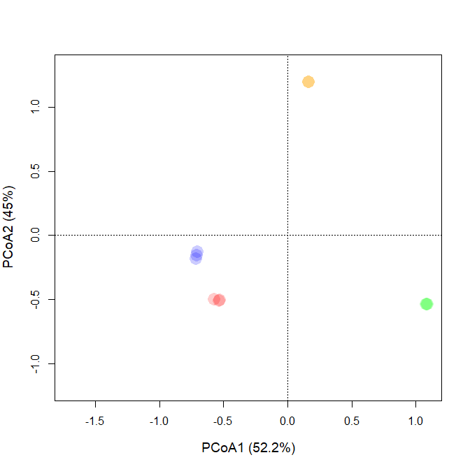
I can start to work towards making this more publication ready…
library("vegan")
inFile <- "C:\\query\\stream_abundance_table_genus.txt"
myT <- read.table(inFile, sep="\t", header=TRUE,row.names=1)
myTData <- t(myT)
categories <- c()
colors <- vector()
for ( i in 1:12 )
{
categories[i] <- substr(row.names(myTData)[i], 1, 3)
if( i >= 1 & i <= 3 )
{
colors[i] = "red"
}
else if ( i >=4 & i <=6 )
{
colors[i] = "blue"
}
else if ( i >=7 & i <=9 )
{
colors[i] = "green"
}
else
{
colors[i] = "orange"
}
}
myPCOA <- capscale(myTData~1, distance="bray")
xAxisLab = paste0("PCoA1 (", format(100 * summary(myPCOA)$cont$importance[2],digits=3),"%)")
yAxisLab = paste0("PCoA2 (",format(100 * summary(myPCOA)$cont$importance[5],digits=3),"%)")
myPlot <- ordiplot(myPCOA,choices=c(1,2),type="none",cex.lab=1.2,xlab= xAxisLab, ylab = yAxisLab)
points(myPlot,"sites",pch=16,cex=2.5,col=adjustcolor(colors, alpha.f = 0.2))
https://github.com/afodor/metagenomicsTools/blob/master/src/scripts/classQueryExamples/quickPCOA.txt

Slide 69
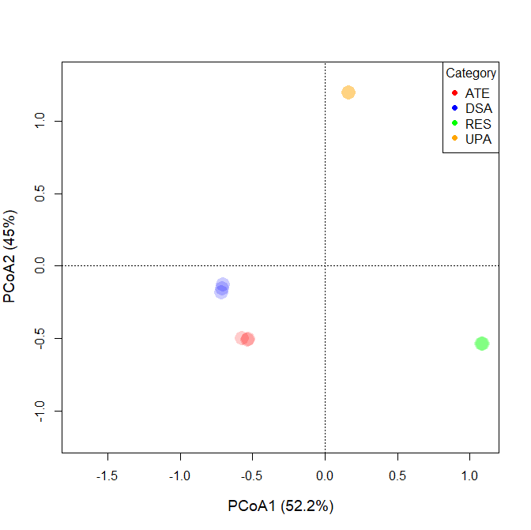
Here is a nice ChatGPT trick…
Given this code:
library("vegan") inFile <- "C:\\query\\stream_abundance_table_genus.txt" myT <- read.table(inFile, sep="\t", header=TRUE,row.names=1) myTData <- t(myT) categories <- c() colors <- vector() for ( i in 1:12 ) { categories[i] <- substr(row.names(myTData)[i], 1, 3) if( i >= 1 & i <= 3 ) { colors[i] = "red" } else if ( i >=4 & i <=6 ) { colors[i] = "blue" } else if ( i >=7 & i <=9 ) { colors[i] = "green" } else { colors[i] = "orange" } } myPCOA <- capscale(myTData~1, distance="bray") xAxisLab = paste0("PCoA1 (", format(100 * summary(myPCOA)$cont$importance[2],digits=3),"%)") yAxisLab = paste0("PCoA2 (",format(100 * summary(myPCOA)$cont$importance[5],digits=3),"%)") myPlot <- ordiplot(myPCOA,choices=c(1,2),type="none",cex.lab=1.2,xlab= xAxisLab, ylab = yAxisLab) points(myPlot,"sites",pch=16,cex=2.5,col=adjustcolor(colors, alpha.f = 0.2))
add a legend to the plot
ChatGPT successfully added the line legend("topright", legend = legend_labels, col = legend_colors, pch = 16, title = "Category")

Slide 70
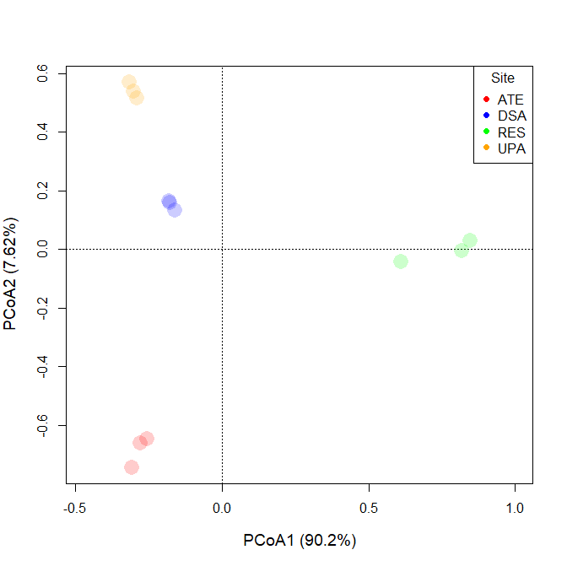
We get a slightly more “realistic” if we log transform our data (and ignore a few warning messages…)
myTData <- -log10( t(myT) + 0.000001)
Without the log, the most dominant taxa
drives most of the information in our
visualization

Slide 71
do I still need to know how to code?
probably
ChatGPT feels like a super-charged stack overflow search
You still have to know what you are doing and why

Slide 72
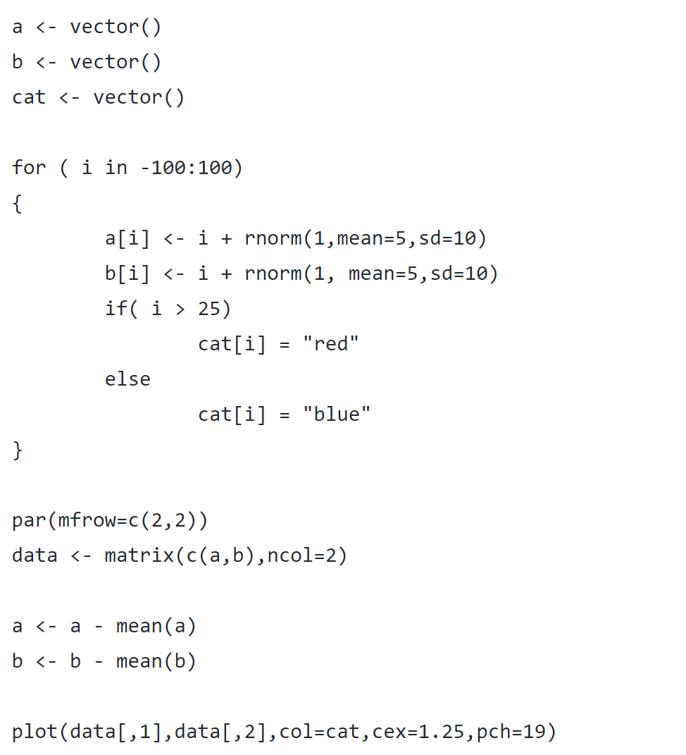
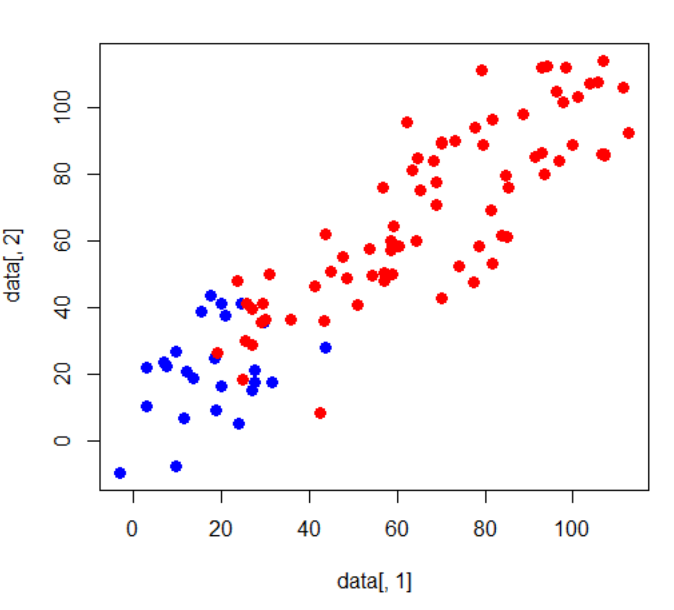
What does PCOA actually do? Consider a simulated 2D dataset
https://github.com/afodor/metagenomicsTools/blob/master/src/classExamples/pcaSim.txt

Slide 73
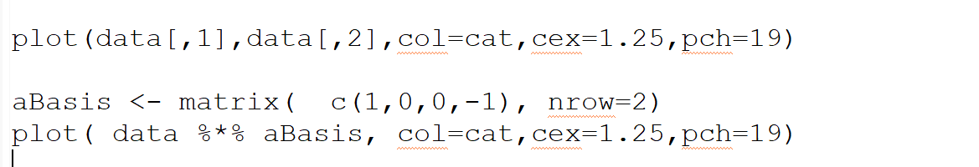
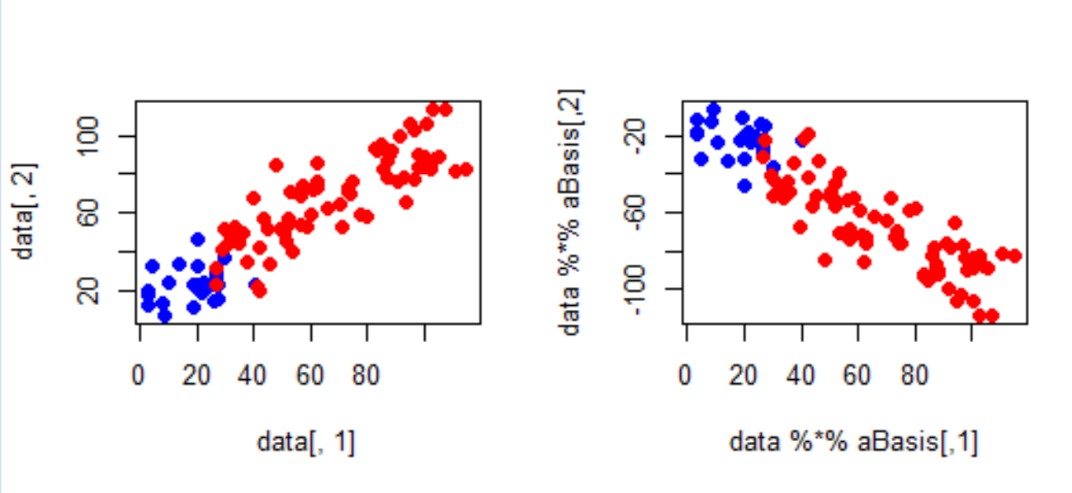
We can rotate these data any way we want to (by any orthornomral basis)
Before rotation
After rotation
https://fodorclasses.github.io/classes/stats2022/Lecture18.pptx

Slide 74
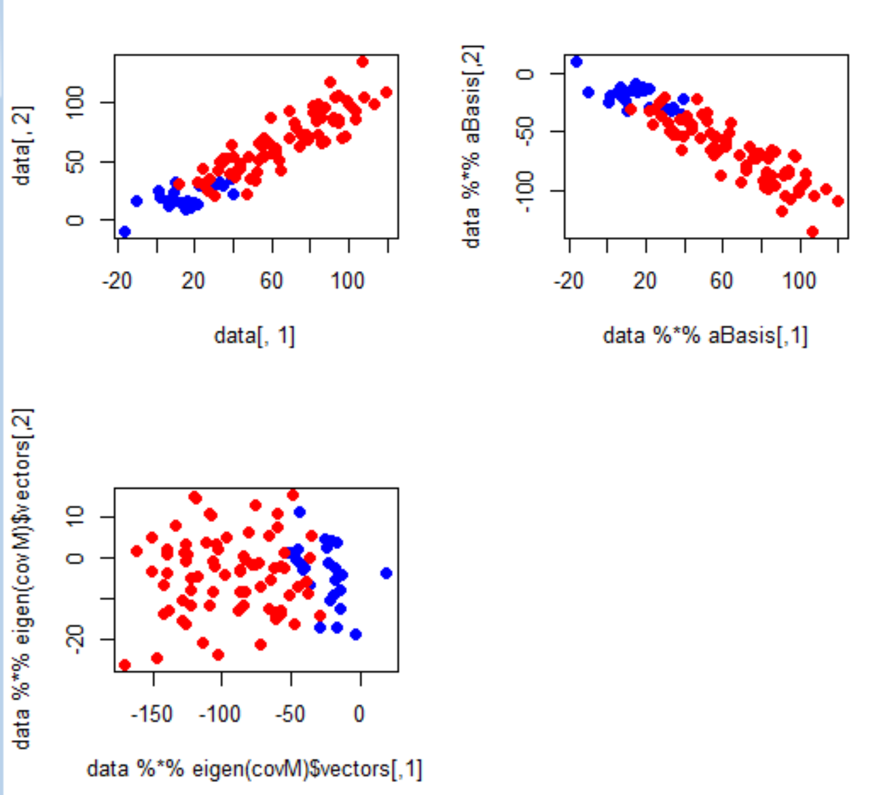

The PCA rotation is the rotation that guarantees that PCA1 will capture the most possible variance of the data in one dimension
We have the option of doing inference (comparing for example red. vs. blue)
in one-dimension (with, for example, a simple t-test) even though we started with
two correlated variables)

Slide 75


We have the option of doing inference (comparing for example red. vs. blue)
in one-dimension (with, for example, a simple t-test) even though we started with
two correlated variables)

Slide 76


Consider the relationship between x and x ^ 2
https://fodorclasses.github.io/classes/stats2022/Lecture19.pptx
https://github.com/afodor/metagenomicsTools/blob/master/src/machineLearningExamples/pcaRotation.txt

Slide 77


Mean subtracting doesn’t much change the basic shape…
https://github.com/afodor/metagenomicsTools/blob/master/src/machineLearningExamples/pcaRotation.txt

Slide 78

We can perform the PCA via Eigen value rotation
[200, 2] * [2,2] = [200,2]
https://github.com/afodor/metagenomicsTools/blob/master/src/machineLearningExamples/pcaRotation.txt

Slide 79

Here, we rotate it back but only use the first PCA component
[200 * 1]
[ 1 * 2 ]
= [200 * 2]
In one linear component,
we can only hold linear
Information…
https://github.com/afodor/metagenomicsTools/blob/master/src/machineLearningExamples/pcaRotation.txt

Slide 80

Of course, if we use both components, we can get the original data back…
[200 * 2] * [2,2] = [200 * 2]
https://github.com/afodor/metagenomicsTools/blob/master/src/machineLearningExamples/pcaRotation.txt

Slide 81


With alternative syntax (but identical results…)
https://github.com/afodor/metagenomicsTools/blob/master/src/machineLearningExamples/pcaRotation.txt

Slide 82


With alternative syntax (but identical results…)
https://github.com/afodor/metagenomicsTools/blob/master/src/machineLearningExamples/pcaRotation.txt

Slide 83

With alternative syntax (but identical results…)
https://github.com/afodor/metagenomicsTools/blob/master/src/machineLearningExamples/pcaRotation.txt

Slide 84
Returning to our PCoA plot,
we can form for the first two PCoA
axes, a null hypothesis that all of the means
are drawn from the same distribution
We asked ChatGPT 3.5 to do this:
(“given the above code, perform a one-way
ANOVA on the first MDS axes with a null
hypothesis that all the categories have
equal mean”)
but the code it generated ran with errors,
so again we code this by hand…

Slide 85


We can plot and run statistical tests on our MDS axes with a few lines of hand-written code
boxplot( scores(myPCOA)$sites[,1] ~ categories,ylab="MDS1",xlab="sites" )
boxplot( scores(myPCOA)$sites[,2] ~ categories,ylab="MDS2",xlab="sites" )
Despite the small sample size, the vast difference between these
sites allows us to easily reject the null hypothesis

Slide 86

We can also do a non-parametric test over the distance metric using ADONIS
(ignoring some error messages)

Slide 87

We can extend our ANOVA analysis for every taxa in the spreadsheet
inFile <- "C:\\query\\stream_abundance_table_genus.txt"
myT <- read.table(inFile, sep="\t", header=TRUE,row.names=1)
pValues <- c()
taxaNames <- c()
categories <- c()
for ( i in 1:12 )
{
categories[i] <- substr(names(myT)[i], 1, 3)
}
for( i in 1:nrow(myT))
{
pValues[i] <- anova(lm(unlist(myT[i,]) ~ categories))$"Pr(>F)"[1]
taxaNames[i] <- row.names(myT)[i]
}
hist(pValues)
We expect a uniform distribution of p-values if the null
hypothesis is always true (which here it is clearly not)
https://github.com/afodor/metagenomicsTools/blob/master/src/scripts/classQueryExamples/quickAnova.txt

Slide 88


The histogram of all p-value is uniform when the null hypothesis is expected to be true!
Simulate an experiment where the null
hypothesis is always true…
Don’t use simple thresholds of p <0.05 for cases where you have evaluate multiple hypotheses!

Slide 89


A simple 0.05 p-value threshold will report 5% true positives even on randomly generated data.
We need a strategy for multiple hypothesis correction
On possibility: use as a p-value threshold Bonferroni correction.
The desired threshold / number of tests.
In this case 0.05 / 20000 = 2.5e-06
None of our p-vals reach this threshold..
At this threshold, there is a 5% chance of any false positives

Slide 90
Bonferroni correction is sometimes considered too conservative for genomics experiments.
At small sample sizes, you might have few genes with p-values smaller than the
Bonferroni thresholds.
A less conservative alternative, false discovery rate.
At a 5% false discovery rate, we expect 5% of our hits to be false positives.
This is less conservative than Bonferroni correction, where there is a 5% chance
that any of our hits are false positives.

Slide 91


One straight-forward approach to finding genes at a given false-discovery rate
Benjamini and Hochberg FDR
1. Rank all the p-values (smallest first). The rank of each value = K
2. Calculate N * p / k
where N = the # of hypotheses that you are testing
p = the “raw” (uncorrected) p-value.
3. Start at the top of the list. Go down to N * p / k > threshold
(e.g. 0.10 for 10% FDR).
N * p = # of expected false positives at a given p-value
k = # of genes actually observed at that p-value

Slide 92
Note that for the first hit (smallest p-value),
Bonferroni correction is the same as BH FDR.
(Since if k=1,
N * p / K = N * p
which is the same as multiplying the p-value by the number of hypotheses to
do the correction)

Slide 93

Here are example results from DeSeq (a popular RNA-seq analysis tool)…
FDR adjusted
p-values..
Raw p-values
You can access BH FDR correction from r with p.adjust( uncorrectedPValues, method=“BH”)

Slide 94

R makes it easy to correct using BH or Bonf correction
myFrame <- data.frame( taxaNames, pValues )
myFrame <- myFrame [order(myFrame$pValue),]
myFrame$adjustedPValues <- p.adjust( myFrame$pValues, method = "BH" )
write.table(myFrame, file="C:\\query\\stream_abundance_genus_Anova.txt",
sep="\t",row.names=FALSE)
https://github.com/afodor/metagenomicsTools/blob/master/src/scripts/classQueryExamples/quickAnova.txt

Slide 95

For good measure, we can make a giant PDF that plots our results out by taxa (sorted by significance)
pdf("C:\\query\\boxplots.pdf")
par(mfrow=c(2,2))
for( i in 1:nrow(myFrame) )
{
row = which( row.names(myT) == myFrame$taxaNames[i] )
mainText = paste( myFrame$taxaNames[i] , "\nfdrP=", format( myFrame$adjustedPValues[i] ,digits=3) )
boxplot( unlist(myT[row,]) ~ categories ,main=mainText,ylab="relative abundance")
}
dev.off()
https://github.com/afodor/metagenomicsTools/blob/master/src/scripts/classQueryExamples/quickAnova.txt

Slide 96
Additional resources from me:
Slides from my last class in statistical models and R programming
https://fodorclasses.github.io/classes/stats2022
Slides from my last Premier Workshop:
https://fodorclasses.github.io/classes/premier_2023/premier_2023.html
Slides from my Premier seminar:
https://fodorclasses.github.io/classes/premier_2023/Premier_Oct5.pptx

Slide 97
WGS analysis can be complex
First questions (ahead of detailed analysis) in low biomass samples should always be
about negative controls and convincing ourselves we have a real signal
It is not difficult to make initial visualizations.
ChatGTP can help, but at least as of version 3.5 for R, coding skills remain important

